Slide 1
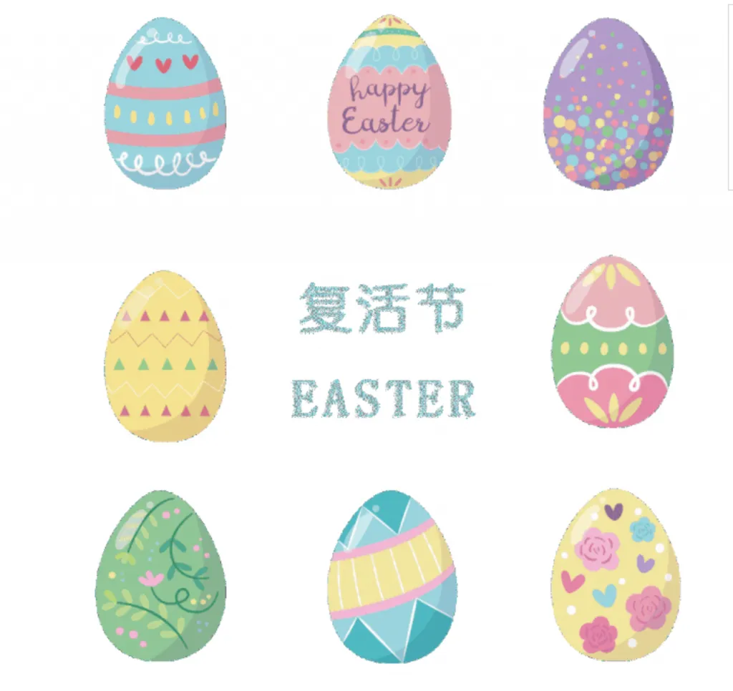
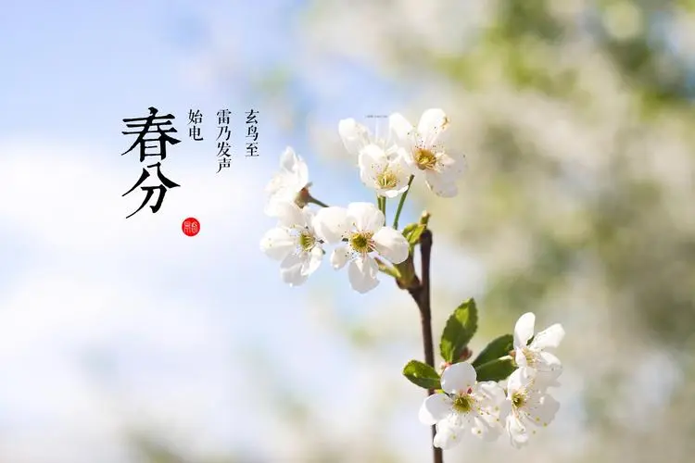
Easter VS Spring Equinox
江昱峰

Slide 2
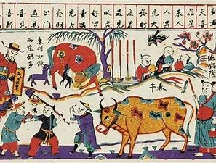
Similarities
Time:Spring
Customs: Related to eggs
Values: welcome to spring and the new life

Slide 3
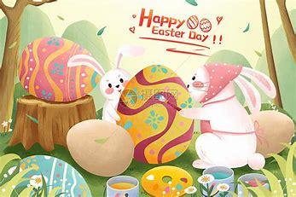
Differences
Specific time: 20th of March-5th of April VS 22th of March-25th of April
Origin: just divide the time VS the resurrection of Jesus
Customs: paint,hind & find the eggs VS make the eggs stand up;
Stick sparrow mouth，send Spring cattle VS eat rabbits and lamb

Slide 4
Thanks for watching!

